Slide 2
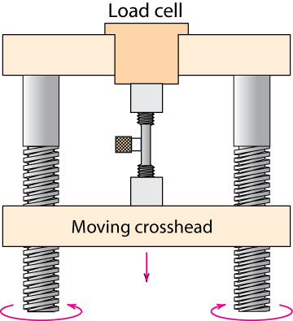
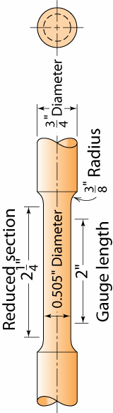
Stress-Strain Testing
Typical tensile testing machine
Typical tensile specimen
extensometer
specimen
gauge
length
Adapted from Fig. 6.3, Callister 7e. (Fig. 6.3 is taken from H.W. Hayden, W.G. Moffatt, and J. Wulff, The Structure and Properties of Materials, Vol. III, Mechanical Behavior, p. 2, John Wiley and Sons, New York, 1965.)

Slide 3
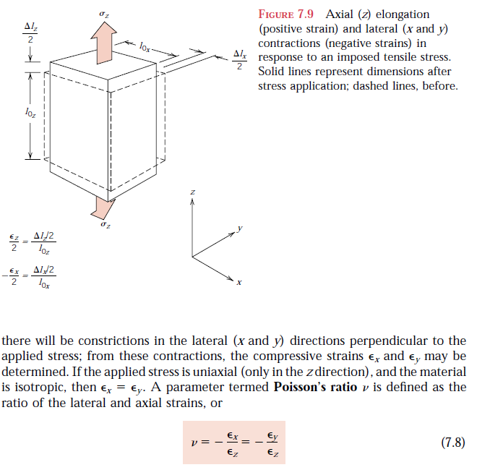
Engineering Stress
Engineering Strain
• Tensile stress, σ:
F
t
δ
/2
Area, A
L
w
o
o
δ
L
/2
F
t
• Tensile strain:
• Lateral strain:
F
t
lb
N
σ
=
=
f
or
δ
= (L_{i}-L_{o})
−
δ
= (r_{i}-r_{o})
A
in
2
m
2
ε
=
ε
=
L
o
L
L
w
o
o
original area
before loading

Slide 4
Poisson's ratio, ν
ε_{L}
• Poisson's ratio, ν:
ε
ν
=
−
L
ε
ε
metals: ν ~ 0.33 ceramics: ν ~ 0.25 polymers: ν ~ 0.40
-
ν
Units:
E: [GPa] or [psi]
ν: dimensionless
ν > 0.50 density increases
ν < 0.50 density decreases (voids form)

Slide 5
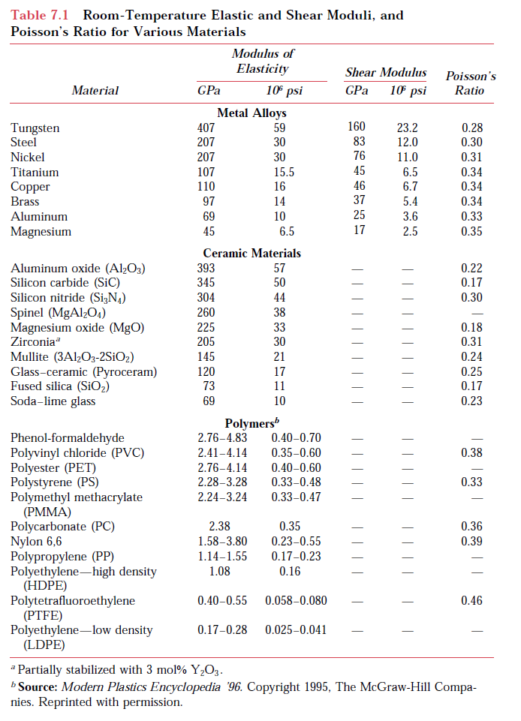
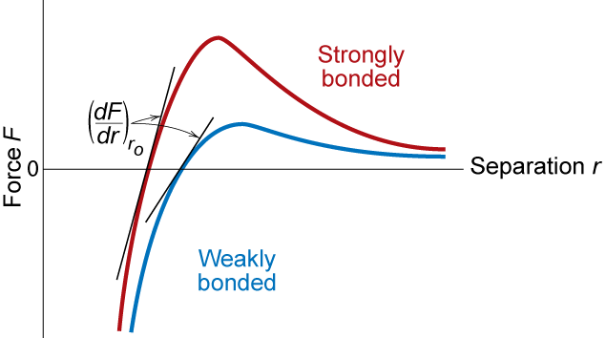
Draw a box to represent the range of E_{Y} for each class of material
E_{Y}
Metals
Ceramics
Polymers

Slide 6
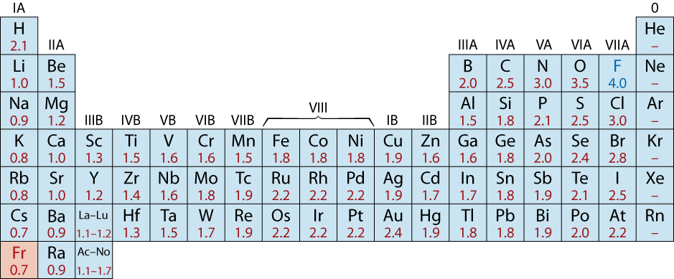
Examples: Ionic Bonding
• Predominant bonding in Ceramics
NaCl
MgO
CaF
2
CsCl
Give up electrons
Acquire electrons
Adapted from Fig. 2.7, Callister & Rethwisch 3e. (Fig. 2.7 is adapted from Linus Pauling, The Nature of the Chemical Bond, 3rd edition, Copyright 1939 and 1940, 3rd edition. Copyright 1960 by Cornell University.

Slide 7
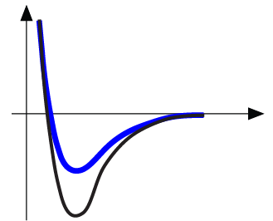
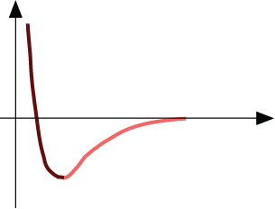
Properties From Bonding: T_{m}
• Bond length, r
• Melting Temperature, T_{m}
Energy
r
• Bond energy, E_{o}
r
o
r
Energy
smaller T_{m}
unstretched length
larger T_{m}
r
o
r
E_{o}
=
T_{m} is larger if E_{o} is larger.
“bond energy”

Slide 8
Properties From Bonding : α
• Coefficient of thermal expansion, α
length,
L
o
coeff. thermal expansion
unheated, T
1
Δ
L
Δ
L
=
α
(
T
-
T
)
L
2
1
heated, T
2
o
• α ~ symmetric at r_{o}
Energy
unstretched length
r
o
r
α is larger if E_{o} is smaller.
smaller α
E_{o}
E_{o}
larger α

Slide 9
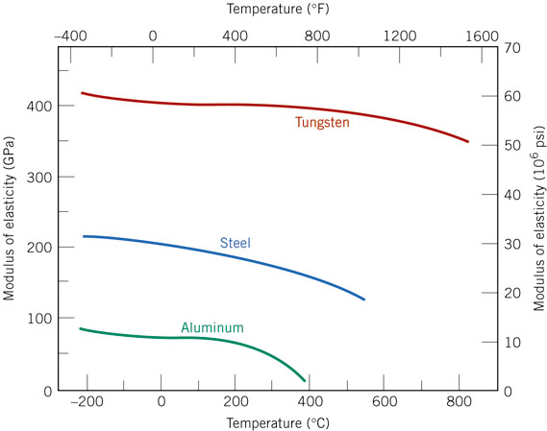
Change with Temperature
So how does the E_{Y} Change with Temp?

Slide 10
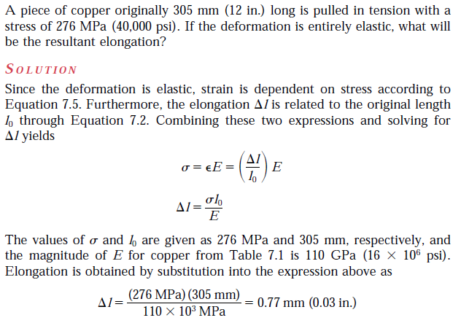
Sample problem

Slide 11
Other Elastic Properties
τ
M
• Elastic Shear
modulus, G:
G
simple
torsion
test
γ
τ = G γ
M
• Elastic Bulk
modulus, K:
P
P
Δ
V
P
P
Δ
V
P = -
K
V
V
o
K
o
pressure
test: Init.
vol =V_{o}.
Vol chg.
= ΔV
• Special relations for isotropic materials:
E
E
G
=
K
=
2(1 + ν)
3(1 − 2ν)

Slide 12
Young’s Moduli: Comparison
Metals
Alloys
Graphite
Ceramics
Semicond
Composites
/fibers
Polymers
1200
10
00
Diamond
8
00
6
00
Si carbide
4
00
Tungsten
Al oxide
Carbon
fibers only
E(GPa)
Molybdenum
Si nitride
2
00
Steel, Ni
C
FRE(|| fibers)*
Tantalum
<111>
Platinum
Si crystal
A
ramid fibers only
10
0
Cu alloys
<100>
8
0
Zinc, Ti
Based on data in Table B2,
Callister 7e.
Composite data based on
reinforced epoxy with 60 vol%
of aligned
carbon (CFRE),
aramid (AFRE), or
glass (GFRE)
fibers.
Silver, Gold
Glass
-
soda
A
FRE(|| fibers)*
6
0
Aluminum
Glass fibers only
4
0
Magnesium,
G
FRE(|| fibers)*
Tin
10⁹ Pa
Concrete
2
0
GFRE*
CFRE
*
10
G
raphite
G
FRE( fibers)*
8
C
FRE( fibers)
*
6
AFRE( fibers)
*
4
Polyester
PET
PS
Epoxy only
2
PC
PP
1
HDP
E
0.8
0.6
PTF
E
Wood( grain)
0.4
0.2
LDPE

Slide 13
Useful Linear Elastic Relationships
• Simple tension:
• Simple torsion:
FL
Fw
2
ML
δ
=
o
δ
=
−
ν
o
α
=
o
E
A
L
E
A
π
r
4
G
o
o
o
F
M = moment
δ
/2
α
= angle of twist
A
o
L_{o}
L_{o}
w
o
2r_{o}
δ
L
/2
• Material, geometric, and loading parameters all
contribute to deflection.
• Larger elastic moduli minimize elastic deflection.

Slide 14
Plastic (Permanent) Deformation
• Simple tension test:
Elastic+Plastic
engineering stress, σ
at larger stress
Elastic
initially
permanent (plastic)
after load is removed
ε_{p}
engineering strain, ε
plastic strain
Adapted from Fig. 6.10 (a),
Callister 7e.
ε_{p} ~ 0.002

Slide 15
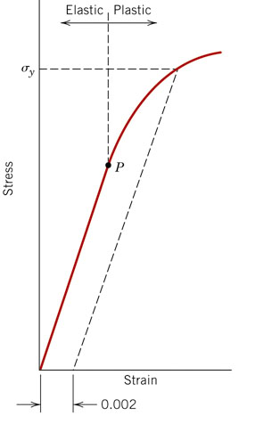
Yield Strength, σ_{y}
• Stress at which noticeable plastic deformation has
occurred.
when ε_{p} = 0.002
σ_{y} = yield strength
Note: for 2 inch sample
ε = 0.002 = Δz/z
∴ Δz = 0.004 in

Slide 16
Compare these three materials
E
ngineering
(ceramics)
tensile
stress,
σ
(metals)
(unreinforced polymers)
Engineering tensile strain,
ε
Brittle fracture: elastic energy Ductile fracture: elastic + plastic energy

Slide 17
Yield Strength : Comparison
Metals/
Graphite/
Composites/
Alloys
Ceramics/
Polymers
fibers
Semicond
2
0
00
Steel
(4140)
qt
10
00
Ti
(5Al-2.5Sn)
a
(MPa)
W
(pure)
7
00
6
00
Cu
(71500)
cw
5
00
Mo (pure)
4
00
Steel
(4140)
a
y
Steel
(1020)
cd
σ
3
00
,
Room T values
Al
(6061)
ag
2
00
Steel
(1020)
hr
¨
Ti
(pure)
a
Ta
(pure)
hr
Hard to measure,
Based on data in Table B4,
Callister 7e.
a = annealed
hr = hot rolled
ag = aged
cd = cold drawn
cw = cold worked
qt = quenched & tempered
Cu
(71500)
Hard to measure
in tension, fracture usually occurs before yield.
since in tension, fracture usually occurs before yield.
in ceramic matrix and epoxy matrix composites, since
100
Yield strength,
dry
70
PC
60
Al
(6061)
a
Nylon 6,6
50
PET
humid
40
PVC
30
PP
H
DPE
20
Tin (pure)
LDPE
10

Slide 18
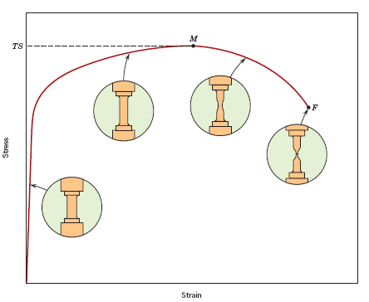
Tensile Strength, TS
• Maximum stress on engineering stress-strain curve.
Adapted from Fig. 6.11, Callister 7e.
TS
F = fracture or
ultimate
strength
Neck – acts as stress concentrator
σ_{y}
Use Yield Strength Instead
stress
engineering
Typical response of a metal
strain
engineering strain
• Metals: occurs when noticeable necking starts.
• Polymers: occurs when polymer backbone chains are
aligned and about to break.

Slide 19
Tensile Strength : Comparison
Metals/
Graphite/
Composites/
Alloys
Ceramics/
Polymers
fibers
Semicond
5000
C
fibers
3000
Aramid
fib
E-glass fib
2000
Steel
(4140)
qt
(MPa)
A
FRE
(|| fiber)
1000
W
(pure)
a
Diamond
GFRE
(|| fiber)
Ti
(5Al-2.5Sn)
a
C
FRE
(|| fiber)
Steel
(4140)
cw
Si nitride
Cu
(71500)
hr
Cu
(71500)
Al oxide
300
Steel
(1020)
Al
(6061)
ag
Room Temp. values
200
Ti
(pure)
a
Ta
(pure)
Al
(6061)
a
Si crystal
wood(|| fiber)
Based on data in Table B4,
Callister 7e.
a = annealed
hr = hot rolled
ag = aged
cd = cold drawn
cw = cold worked
qt = quenched & tempered
AFRE, GFRE, & CFRE =
aramid, glass, & carbon
fiber-reinforced epoxy
composites, with 60 vol%
fibers.
100
<100>
strength, TS
Nylon 6,6
Glass-soda
PC
PET
40
Concrete
PVC
GFRE
( fiber)
30
PP
C
FRE
( fiber)
H
DPE
A
FRE( fiber)
20
Graphite
L
DPE
10
Tensile
wood
( fiber)
1

Slide 20
Design or Safety Factors
• Design uncertainties mean we do not push the limit.
• Factor of safety, N
Often N is
between
1.2 and 4
• Example: Calculate a diameter, d, to ensure that yield does
not occur in the 1045 carbon steel rod below. Use a
factor of safety of 5.
d
1045 plain
carbon steel:
σ
L
o
y
= 310 MPa
5
TS = 565 MPa
d = 0.067 m = 6.7 cm
F = 220,000N

Slide 21
Ductility
• Plastic tensile strain at failure:
(%EL =Percent elongation)
L
−
L
%
EL
=
f
o
x 100
L
o
smaller %EL
E
ngineering
tensile
stress,
σ
larger %EL
A_{o}
L_{o}
A_{f}
L_{f}
Adapted from Fig. 6.13, Callister 7e.
Engineering tensile strain,
ε
This is usually geometry dependent and therefore l_{o} must also be given
A
-
A
• Another ductility measure:
(%RA =Percent reduction in area)
=
o
f
%
RA
x
100
A
o

Slide 22
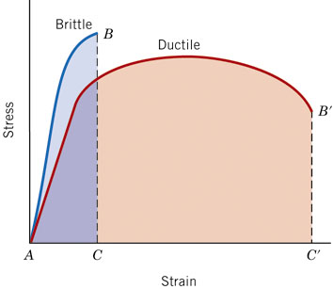

Slide 23
How do we quantify ductility?
• Plastic tensile strain at failure:
(%EL =Percent elongation)
L
−
L
%
EL
=
f
o
x 100
L
o
smaller %EL
Engineering
tensile
stress,
σ
larger %EL
L_{o}
A_{o}
A_{f}
L_{f}
Engineering tensile strain,
ε
This is usually geometry dependent and therefore l_{o} must also be given
A
-
A
• Another ductility measure:
(%RA =Percent reduction in area)
=
o
f
%
RA
x
100
A
o

Slide 24
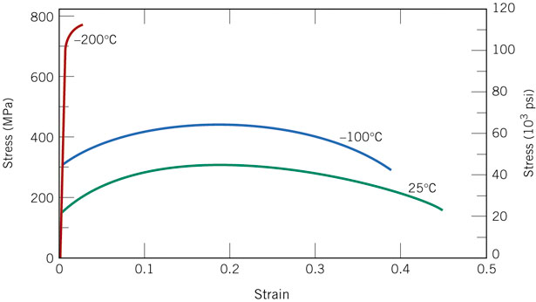
How does Ductility Change with Temperature?
Stress/strain curves for Iron at different temperatures

Slide 25
What does the area under the curve signify?
Engineering
tensile
stress,
σ
Engineering tensile strain,
ε
Brittle fracture: elastic energy Ductile fracture: elastic + plastic energy

Slide 26
Toughness
• Energy to break a unit volume of material
• Approximate by the area under the stress-strain
curve.
small toughness (ceramics)
large toughness (metals)
Engineering
tensile
very small toughness
stress,
σ
(unreinforced polymers)
Engineering tensile strain,
ε
Brittle fracture: elastic energy Ductile fracture: elastic + plastic energy

Slide 27
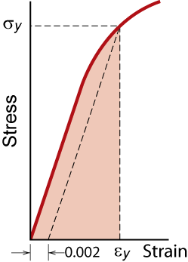
What if you only include the elastic region?

Slide 28
Resilience, U_{r}
Ability of a material to store energy
Energy stored best in elastic region
If we assume a linear stress-strain curve this simplifies to
1
U
≅
σ
ε
r
2
y
y
Adapted from Fig. 6.15, Callister 7e.

Slide 29
Concepts we went over so far
Stress and strain
Yield stress
Tensile Stress
Young’s Modulus
Toughness
Ductility
Elastic and plastic behavior
What about hardness?

Slide 30
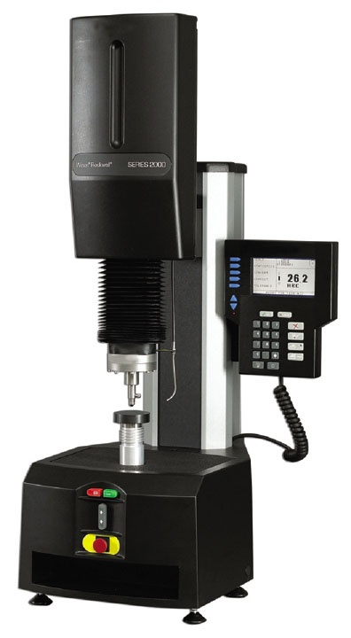
Hardness
• Resistance to permanently indenting the surface.
• Large hardness means:
--resistance to plastic deformation or cracking in
compression.
--better wear properties.
apply known force
measure size
e.g.,
of indent after
10 mm sphere
removing load
Smaller indents
D
d
mean larger
hardness.
most
brasses
easy to machine
cutting
nitrided
plastics
Al alloys
steels
file hard
tools
steels
diamond
increasing hardness

Slide 31
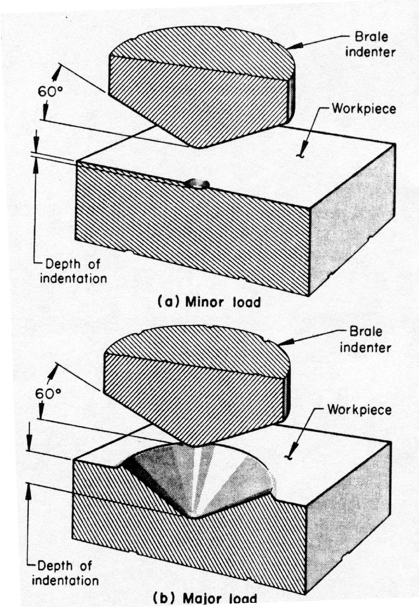
Hardness Test
Indenter is pre-loaded into the
component to be measured.
A major load is then applied,
and the indeneter causes
localized plastic deformation.
The size/depth of the indentation (usually 1-2 mm)
is measured and is inversely
related to the Hardness.

Slide 32
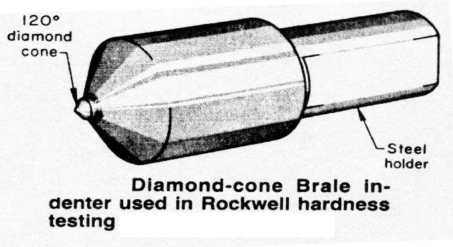
Rockwell Diamond Cone

Slide 33
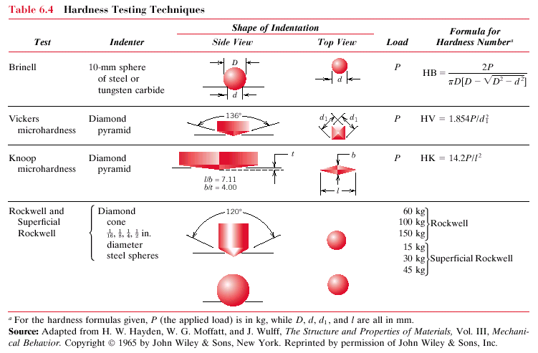
Hardness: Measurement
Table 6.5

Slide 34
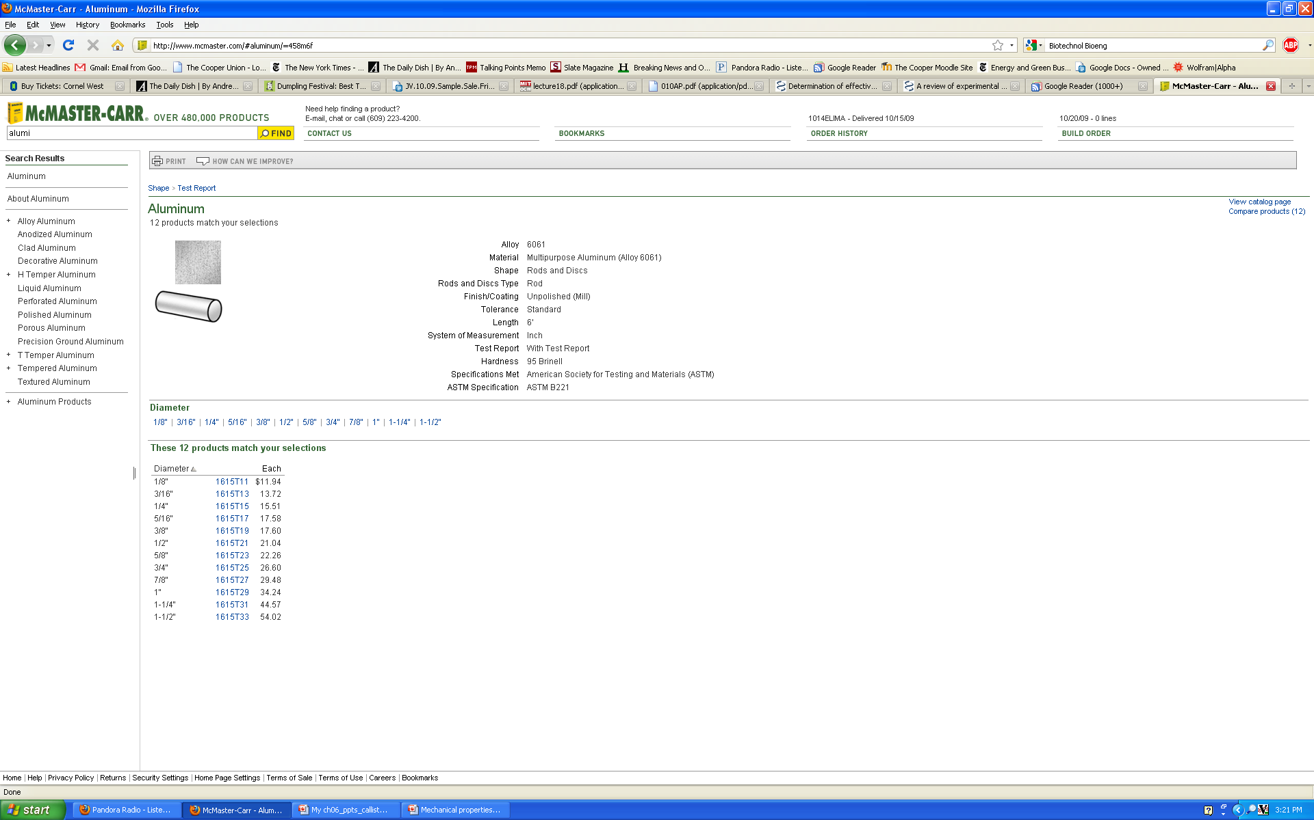
Sample material selection

Slide 35
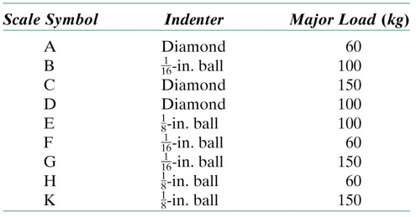
Rockwell Hardness
HR = Rockwell Hardness
No major sample damage
Several overlapping scales.
Each scale runs to 130 but only useful in range 20-100.
Minor load 10 kg
Major load 60 (A), 100 (B) & 150 (C) kg
A = diamond, B = 1/16 in. ball, C = diamond
You write 80 HRB meaning the material scored 80 on the Rockwell hardness “B” scale

Slide 36
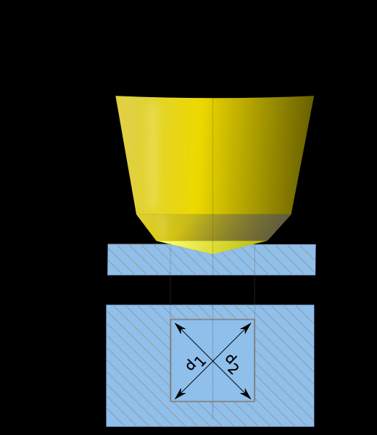

Vickers Hardness Test
Material | Value
316L stainless steel | 140HV30
347L stainless steel | 180HV30
Carbon steel | 55–120HV5
Iron | 30–80HV5
http://upload.wikimedia.org/wikipedia/commons/d/db/Case_hardened_steel-vickers_hardness_tes

Slide 37

Vickers Test
Vickers hardness numbers are reported as xxxHVyy, e.g. 440HV30, or xxxHVyy/zz if duration of force differs from 10s to 15s, e.g. 440Hv30/20, where:
440 is the hardness number,
HV gives the hardness scale (Vickers),
30 indicates the load used in kg.
20 indicates the loading time if it deffers from 10s to 15s
Vickers values are generally independent of the test force: they will come out the same for 500gf and 50kgf, as long as the force is at least 200gf

Slide 38
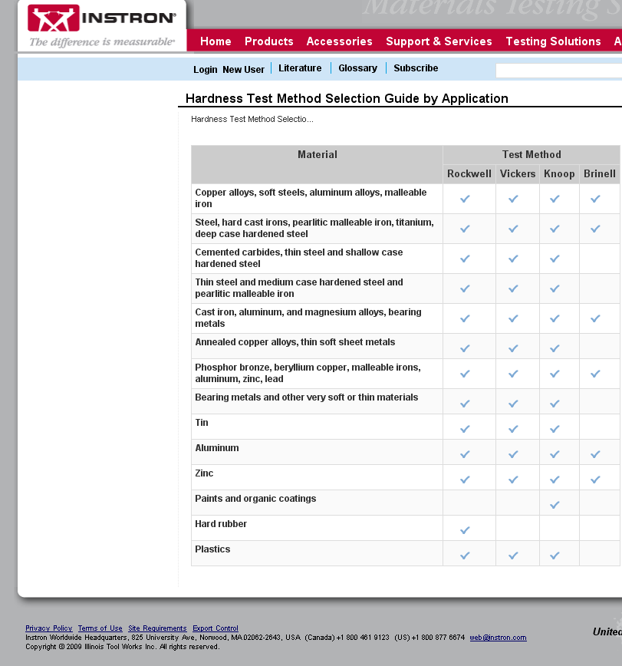
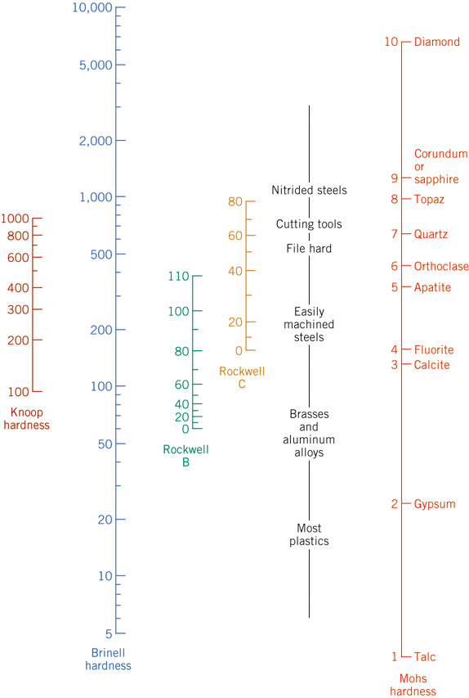
Comparing the Hardness Test Methods

Slide 39
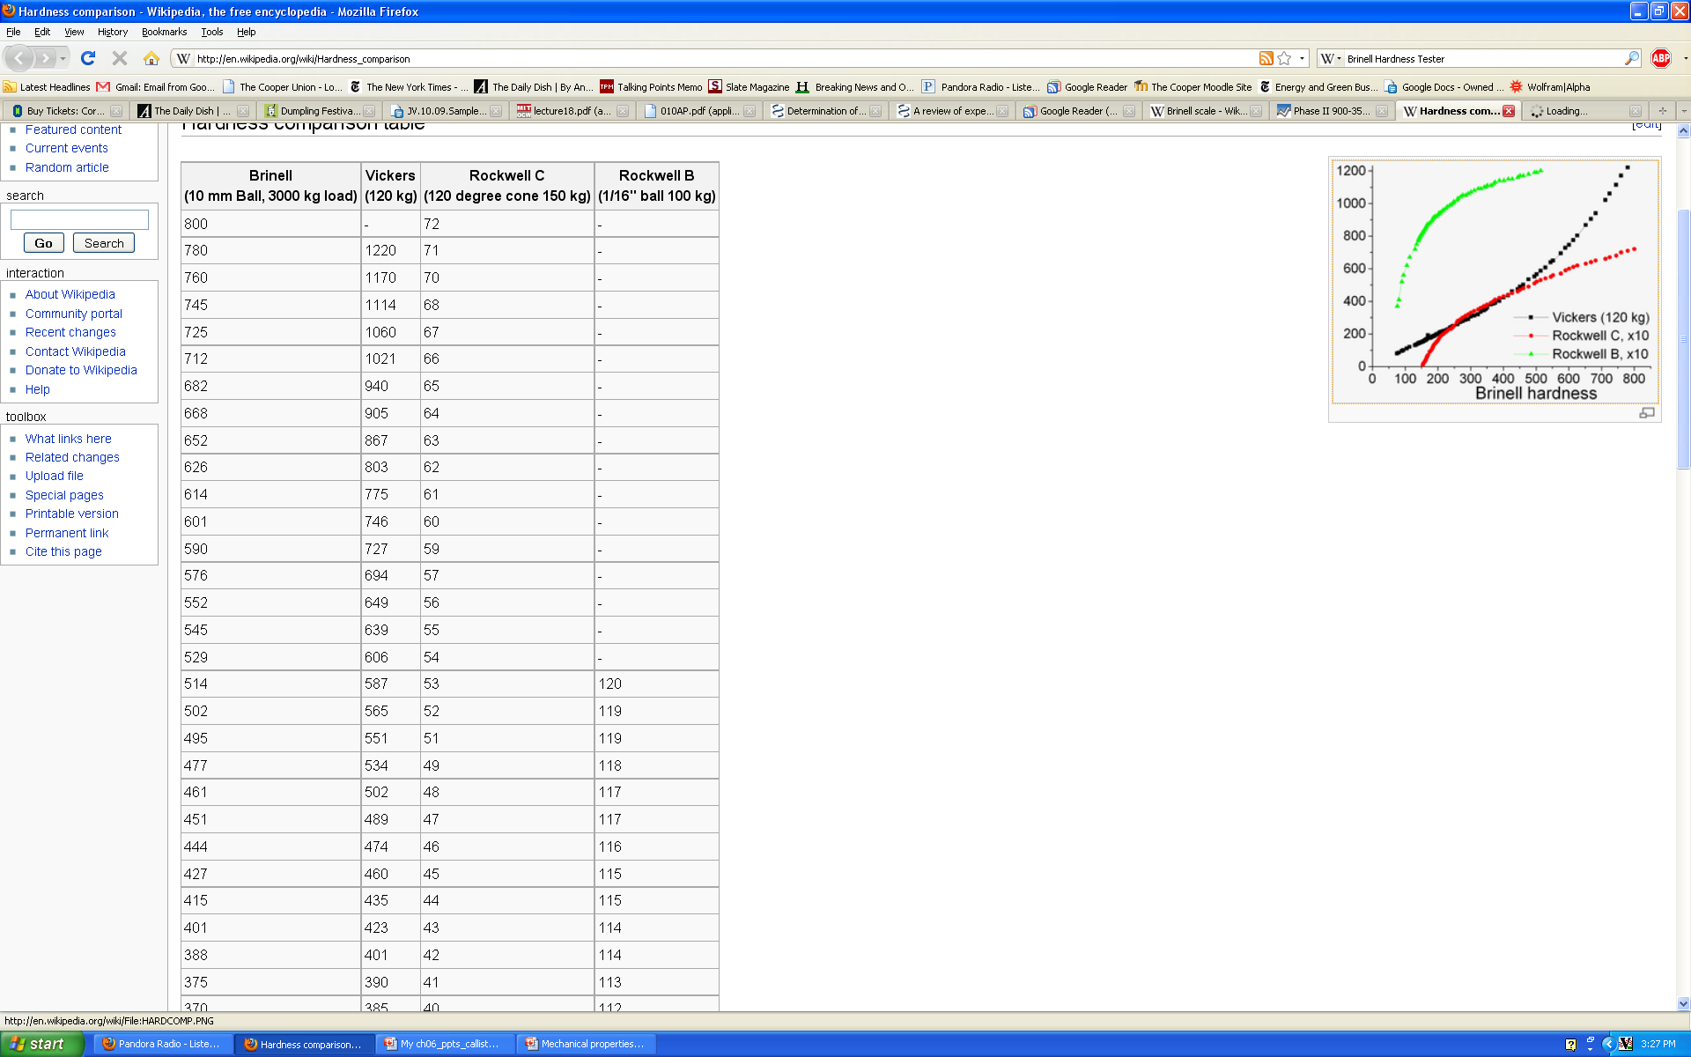
Comparison between the different testing protocols is difficult

Slide 40
Variability in Material Properties
Elastic modulus is material property
Critical properties depend largely on sample flaws (defects, etc.). Large sample to sample variability.
Statistics
Mean
Standard Deviation
where n is the number of data points
Notes:
All samples have same value
Because of large variability must have safety margin in engineering specifications

Slide 41
Summary
• Stress and strain: These are size-independent
measures of load and displacement, respectively.
• Elastic behavior: This reversible behavior often
shows a linear relation between stress and strain.
To minimize deformation, select a material with a
large elastic modulus (E or G).
• Plastic behavior: This permanent deformation
behavior occurs when the tensile (or compressive)
uniaxial stress reaches σ_{y}.
• Toughness: The energy needed to break a unit
volume of material.
• Ductility: The plastic strain at failure.

Slide 42
Summary
• Stress and strain: These are size-independent
measures of load and displacement, respectively.
• Elastic behavior: This reversible behavior often
shows a linear relation between stress and strain.
To minimize deformation, select a material with a
large elastic modulus (E or G).
• Plastic behavior: This permanent deformation
behavior occurs when the tensile (or compressive)
uniaxial stress reaches σ_{y}.
• Toughness: The energy needed to break a unit
volume of material.
• Ductility: The plastic strain at failure.

Slide 43
ANNOUNCEMENTS
Reading:
Core Problems:
Self-help Problems:

Slide 44
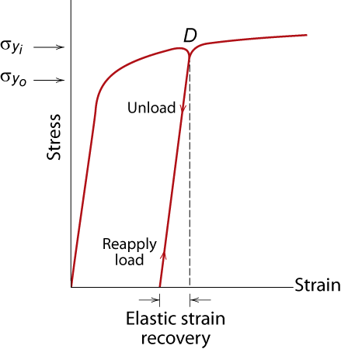
Elastic Strain Recovery
Adapted from Fig. 6.17, Callister 7e.

Slide 45
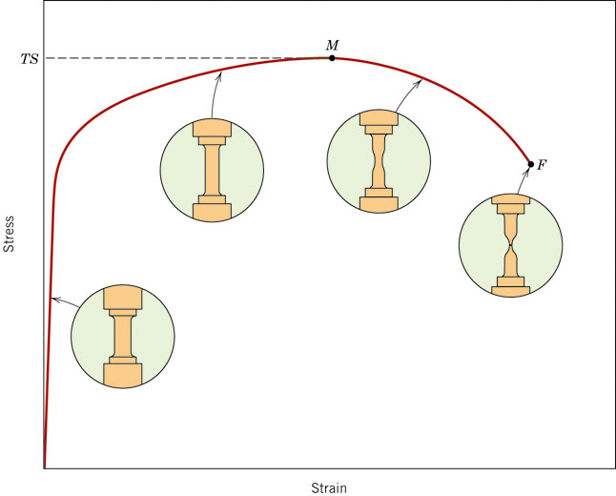
True stress and True Strain
What’s happening to the material properties in this region?

Slide 46
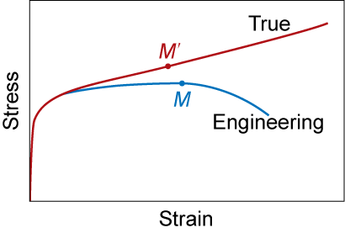
True Stress & Strain
Note: S.A. changes when sample stretched
True stress
True Strain
Adapted from Fig. 6.16, Callister 7e.

